Slide 1
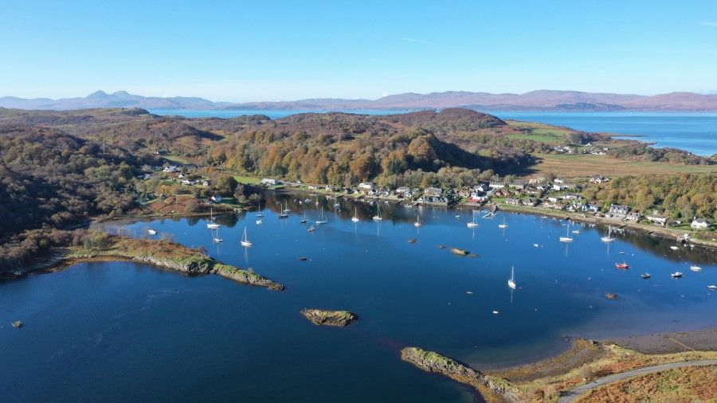
Tayvallich Bay Association
3 year development guidelines

Slide 2
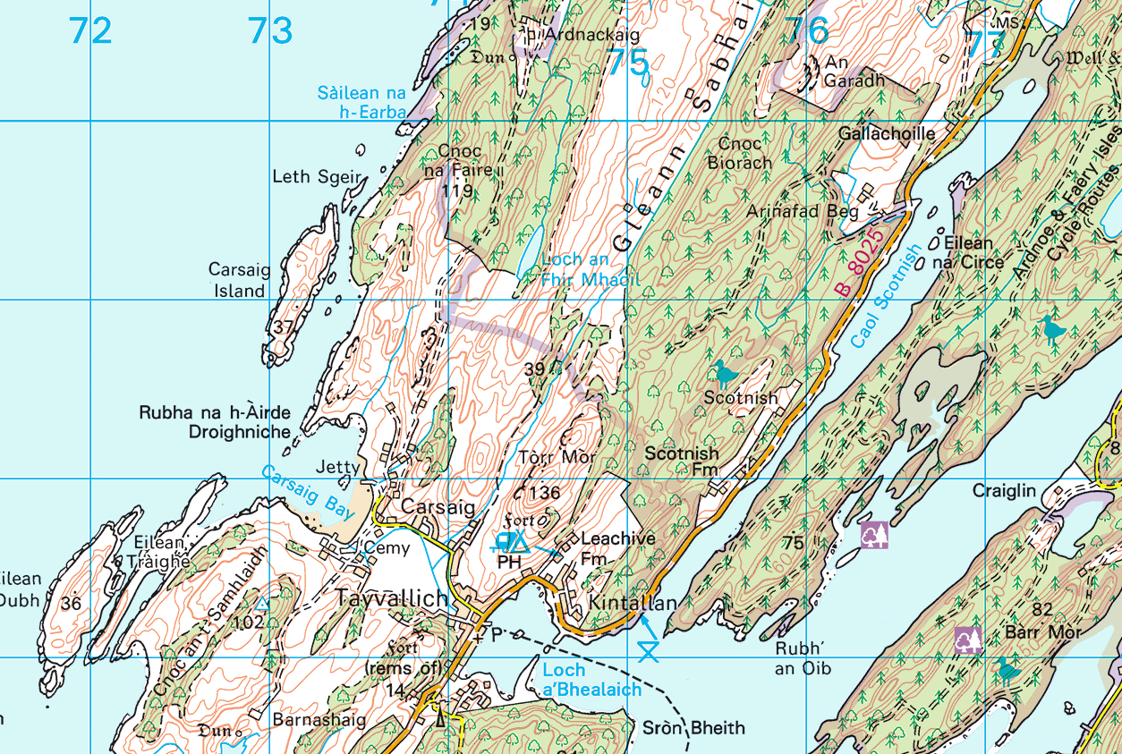
Area of interest & objectives of the TBA
The area of interest for the TBA is Tayvallich Bay and Caol Scotnish, to the head of the loch and extending eastwards to a line joining the Point of Oibh (Rubh ‘An Oib) to Taynish Point (Sròn Bheith).
The objectives of the TBA are:-
To promote developments and improvements within Tayvallich Bay whilst preserving the integrity of the Bay and its environs for the benefit of all stakeholders and the general public.
To regulate and manage moorings, and to negotiate and maintain a lease of the area with the Crown Estate.
To liaise with appropriate local and national organisations and bodies.
Notes:
Th

Slide 3
Purpose and management of these guidelines
These guidelines are used by the TBA to assist decision making, by describing the development goals of the TBA for the forthcoming [3] years.
The guidelines are reviewed by the TBA committee before each annual general meeting (AGM), based on the events of the previous year and communications / requests from the members.
Prior to each AGM the committee will draft any suggested amendments for that year and then circulate the proposed amendments for that year to the TBA members. Any proposed changes to the guidelines will then be discussed and decided by the members at the AGM.
Annual update process:-
Existing guidelines
Committee identify that amendments are required
Committee send out proposed amendments to the members before the AGM
Amendments are discussed and decided at the AGM
Updated guidelines for the year

Slide 4










Which stakeholders / 3rd parties are affected by these guidelines?
The TBA recognises that these development guidelines affect the stakeholders and 3rd parties shown below, and will consider each of these elements when amending them.
Highland Rewilding
Mooring holders
Residents
Local businesses
Commercial operators
TBA development guidelines
Effect on the environment
Visitors
Paddlers
Divers
Swimmers

Slide 5
Development guidelines for the period
[Jan 2022 – Dec 2025]
Notes:
The Development period is over 3 years and its split into each area of responsibility

Slide 6
Governance
TBA Overview | The TBA registered as a Private Company Limited by Guarantee in December 2021. Tayvallich Bay Association Limited. Company House’s standard articles of assocation have been adopted The TBA’s Constitution and Rule remain in place A Chartered Accountant has been engaged to sign off annual accounts Committee should have a minimum of 6 and maximim of 8 members
Current issues | Provide members with a undated set of accounts and report annually at the AGM AGM to be held annually. Constitution states November. Membership have requested that it is held earlier in the year. Not so much of an issue if the meeting can also be held via zoom. Website and database need updated. Significant cost involved.
Potential development within the next 3 years | Consider updating Consitution and Rules Develop new Website (identify if anyone in the membership could assist) Review insurance policy (complete in 2023)
Further potential development, currently out-with the plans for the next 3 years
Notes:
Each section includes a description, and current issues, plans for the next 3 years, and any additional development ideas or plans.
For example we’ve added to consider reviewing the Constitution.

Slide 7
Private Moorings
TBA Overview | Private swinging moorings continue to provide the best use of the waters within Tayvallich Bay Development of additional moorings outside Tayvallich Bay (within the outer bay and Caol Scotnish) are not supported. The Crown Estate allows up to 130 moorings within Tayvallich Bay. The TBA have allocated 109 as private moorings which is felt to be appropriate for the available space.
Allocation of moorings | The TBA allocates moorings according to the following priorities:- Category A – Applicants who have a permanent address and reside in Tayvallich Category B – Applicants who have a holiday home or caravan in Tayvallich Category C – Applicants from outwith Tayvallich
Current issues | October 2022 Waiting list for moorings, currently [28] including [1] category A applicants [6] category B [21] category C October 23 [4] B list [34] C list 2 allocations Review of annual fees. (issues around ongoing maintenance costs) After review of maintenance fees were increase to £300 from 2024. To be reviewed at next AGM. 2022 Annual declarations continue to be requested Multiple dinghies owned by mooring holders being stored on the water at the inner pontoon Moorings being held by owners for more that 2 years without them using it for their own boat.
Potential development within the next 3 years | Contact category C applicants to confirm link to the village. Continue to liaise with mooring holders on a ‘use it or lose it’ basis, to ensure that moorings are actively used Continue to implement ways to improve the declaration return %. Reminder added to invoice. Committee to send out specific email reminder. Encourage mooring holders to notify the TBA if their mooring will not be used for a period in excess of 2 months, so that the TBA may temporarily share vacant moorings. Members enouraged to move dingys as required. Rope along the length of the inner pontoon to allow better mooring of dinghys From 2024 - Charge for use of dinghy pontoons. £25 for a year (tag to be issued. Shallow mooring to move unused dinghy's to.
Further potential development, currently out-with the plans for the next 3 years | Create a new dinghy storage facility (see onshore facilties section)
Notes:
The is a key area of management.
This includes information about the waiting list numbers and allocations etc. We’ll update this section with what has been discussed….. No other significant issues that the Committee feel need to be included ….. Any questions?

Slide 8
Visitor Moorings
TBA Overview | Visiting yachts are an integral part of the Tayvallich culture, most commonly during the summer months Cruising on the West Coast is expected to continue to increase, and it is expected that visiting yacht numbers will stay at a similar level or increase over the next 3 years Visiting yachts can benefit local businesses such as the shop, pub, local artists etc. Provision of temporary moorings, and additional onshore facilites, attracts visiting yachts which provides an overall benefit to Tayvallich
Target number of visitor moorings | There are currently 4 visitor moorings The TBA believe that 4 visitor moorings is an appropriate number (one additional mooring was added in 2021)
Current issues | Visiting yachts using the pick-up line to moor, and therefore use more swinging room than intended Visiting boats using visitors mooring for longer that the advised period. No issue 2022. The TBA committee allocating visitor moorings to boats on the waiting list Large number of category C applicants on the list.
Potential development within the next 3 years | Add note to pick up buoy to say not to be used for mooring Consider allocating visitor moorings to people on the waiting list for winter mooring to create additional revenue.
Further potential development, currently out-with the plans for the next 3 years
Notes:
This includes previous issues picked up at AGM’s or from members. Committee have not had any particular issues this year…. No need for them to be used for long term use, visitors have contacted us via phone or email and paid.

Slide 9
Onshore facilities – Pontoon & Slipway, and Carrick Pier
TBA Overview | The pontoons next to the shop are a key facility for almost all users of Tayvallich bay and the surrounding waters The pontoons are intended for use by:- Mooring holders, for temporary drop off/pick up, water etc. Visiting yachts for overnight and drop off/pick up, water etc. Visiting day-boats (ribs etc.) for short term berthing The Jura ferry (see commercial operators slide) Other commercial passenger / tour boats (see commercial operators slide) The slipway is an essential facility for locals and visitors to launch and retrieve small craft The Carrick Pier is essential to, and primarily for, the use of commercial fishing vessels. All members are free to make use of this facility with consideration given to commercial users. 2 power points were added to the pontoon in 2022.
Current issues | Maintenance of the existing facilities. (membership voted not to progress with large funding application to fund projects 1 and 2) All maintenance must be planned based on current income streams. Long term agreement for cost sharing with the Jura Ferry (see commercial use) Ongoing review of power payments/ usage/ option to add more. Bins at top of pontoon overflowing – 2023 appears to be resolved by raising the issue locally and with the Community Council. Assume less locals are using the bins inappropriately.
Potential development within the next 3 year (see the following slides for proposals) | Maintenace review 2020. Delay replacement of the bridge until 2024/25. This will be a significant cost (Estimated at £55k) Income from next 2 years fees/charges would just cover this but leave no contingency money. In addition the committee would continue to apply for any grant funding opportunities to complete any of the suggested options as individual projects over a longer period of time. Application submitted to Crown estate to add solar panels/upgrade sailing club area. Put in place charges for using Carrick Pier for launching/retrieving leisure boats) This was agreed as £50
Further potential development, currently out-with the plans for the next 3 years | Projects 1 and 2 have been moved to the end of the development plan. They will stay in the development plan for future consideration. Water supply Purchase land from MacLeods (suggested value £20. Discussion to be taken forward 2023/24)
Notes:
Currently the most significant part of the development plan.
It covers
The past years upgrade works
What essential maintenance is required in the next 3 years
What other additional work we might want to consider.
Since the last AGM we resubmitted the application to TS to fund work to support the JPF. That upgrade work has now been completed

Slide 10
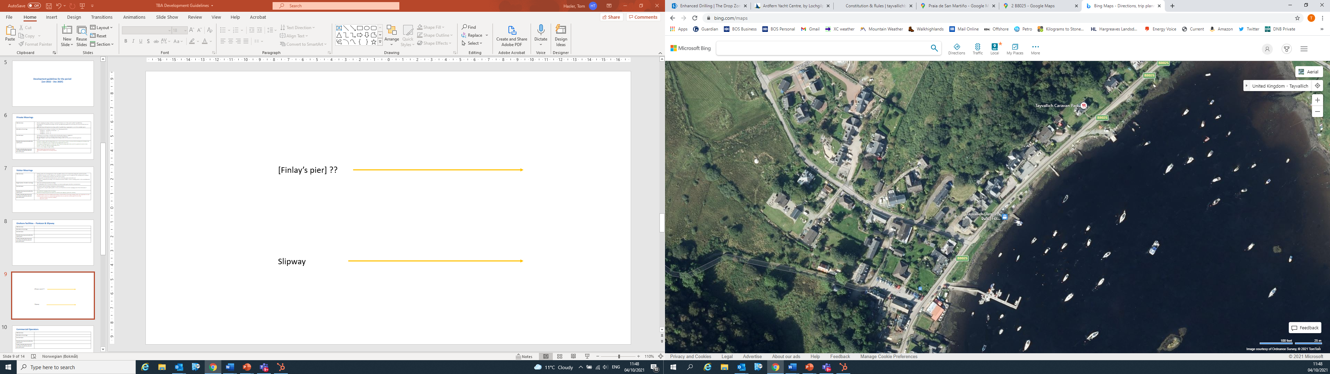
Onshore facilities within TBA control
Carrick Pier
Finlay’s pier
Slipway
Pontoons
Foreshore area

Slide 11
Maintenance of current facilities agreed Oct 2022
Year | Maintenance required | Estimated cost | Total cost | Comments
2022/23 | Pontoon and cardinal inspection Visitor mooring service Electrical misc. | £500 £1000 | Keep costs to minimum | Excluding any materials
2023/24 | Bridge replacement /floating section 1st section of pontoon Replace dinghy fingers | £15,000 £15,000 £20,000 | £50,000 | Examples of floating pontoon would cost more (see next slide)
2024/25 | Post Office Pier Replace pontoon finger | £30,000 £12,000 | £42,000 | May have to spread over 2 years
Year
Notes:
New timetable.
I’m just going to skip back to P1 and P2

Slide 12
Maintenance of current facilities agreed Oct 2023
Year | Maintenance required | Estimated cost | Total cost | Comments
2022/23 | Pontoon and cardinal inspection Visitor mooring service Electrical misc. Water management | £500 £1000 | £2350.59 | Completed
2023/24 | Routine maintenance | £3000 |  | Increase membership fees, contact TS/JDT.
Delay to 24/25 | Bridge replacement /floating section 1st section of pontoon Replace dinghy fingers | £15,000 £15,000 £20,000 | £50,000 Increase estimate to £55,000 | Examples of floating pontoon would cost more (see next slide) Based on current subs we would have that but would not leave and contingency.
2025/26 | Post Office Pier Replace pontoon finger | £30,000 £12,000 | £42,000 | May have to spread over 2 years
Year
Notes:
New timetable.
I’m just going to skip back to P1 and P2

Slide 13
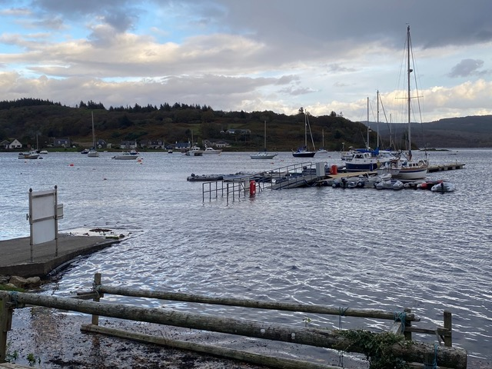
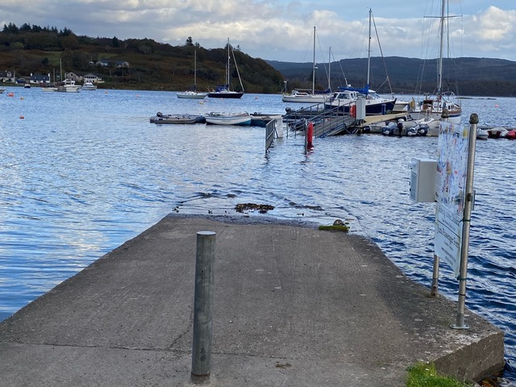
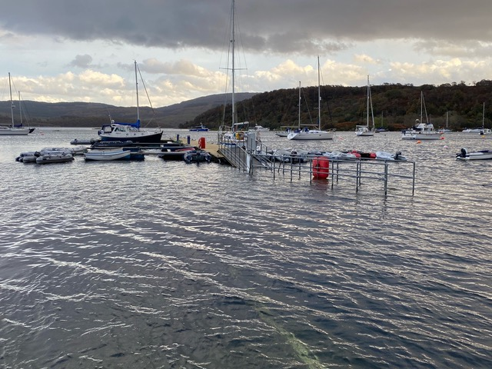
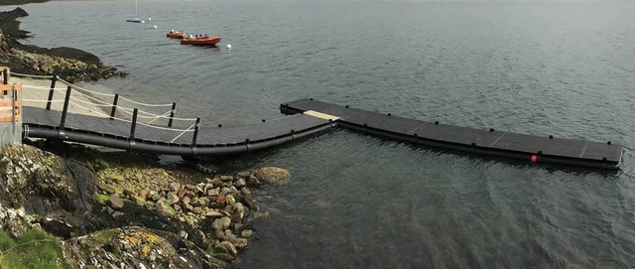
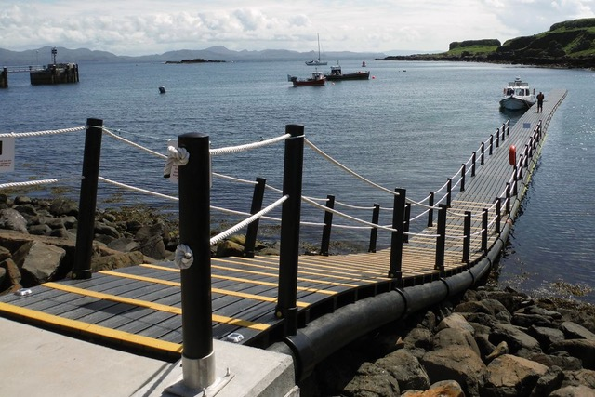
Examples of high tide cutting off the pontoon
Potential solution

Slide 14
Commercial Operators
TBA Overview | Commercial marine operations are a historical and integral part of Tayvallich, and bring visitors and employment opportunities to the community There are 7 moorings allocated to Commercial vessels. The onshore facilities managed by the TBA should facilitate commercial operators where possible Commercial operators should contribute to the maintenance of the onshore facilities as follows:- Carrick Pier – 100% of the maintenance cost recovered from the commercial fishing boats using the pier Annual fees paid by all commercial boats. This is based on the size of their business and use of facilities. Pontoon – a fair contribution from the Jura Ferry and private commercial operators.
Current commercial operators within Tayvallich Bay | Commercial fishing vessels Jura Ferry Private tour / angling vessels Small cruise vessels anchoring in the outer bay
Current issues | No contribution from Jura Development Trust for maintenance. JDT are saying that they have no budget. Fishing boat operators would like upgraded facilities. Mess on Carrick Pier Rafts in outer bay must be removed
Potential development within the next 3 years | Make a long term agreement with the Jura development trust for a contribution to the pontoon maintenance – ongoing 2023/34. Improve agreements with visiting Cruise boats for mooring and landing on the pontoon. Invoices being sent and payment improved. Apply to the Marine Fisheries Fund to improve servies for commericial fishing boats – see below Proposal to purchase land from MacLeods
Further potential development, currently out-with the plans for the next 3 years | Diesel at the pier Water at pier Floating pontoon Power at pier
Notes:
Hans – I’ll let Hans cover this.

Slide 15
Non powered recreational use
TBA Overview | The Tayvallich area, and Caol Scotnish in particular, is an ideal area for paddle-sports, swimmers etc. Paddle sports allow low cost enjoyment of our waters, with the lowest environmental impact The TBA will encourage and support the increase in this type of use of the bay.
Current issues | No easy launch / retrieval location No membership available for paddlesports
Potential development within the next 3 years | Incorporate a launch and retrieval facility for paddle-sports within a new dinghy facility at Finlay’s pier Create membership package for paddle sports.
Further potential development, currently out-with the plans for the next 3 years
Notes:
No current significant plans, but the Committee feel that it is important to include this ……

Slide 16
Impact on the environment and sustainability
TBA Overview | The TBA is responsible for both the Bay and the Outer Bay and Caol Scotnish, which lead onto Loch Sween and make up part of a natual heritage sight and area of special interest because of its diverse wildlife. We have a responsiblity to protect this area. Marine tourism is in an ideal postition to move towards more sustainable methods of sailing, boating and other water sports that will all contribute to protecting our environment and contributing to the challenges surrouding climate change. The TBA can play a role in supporting change and promoting this. The TBA Committee believes any development needs to be done sensitively, maintaining the core objectives of the Association, what makes Tayvallich Unique and protecting areas of special natural interest.
Current issues | Concerns have been raised about water quality in the bay with septic tanks and holding tanks dishcharging into the bay
Potential development within the next 3 years | Current development of the pontoon will include the provision of electric charging points. Issue regarding water quality has been raised with The Community Council. Minutes of 2022 AGM to be circulated to the whole village to raise awareness.
Further potential development, currently out-with the plans for the next 3 years
Notes:
We feel its very important to acknowledge out role in protecting the area that we are responsible for from an environmental perspective.
We’ve included the Septic tank ….. already covered or Hans to update.
Any questions or points that anyone want to raise?
We will update the plan and issue it with a minute of the meeting. Next year we will send out the proposed changes prior to the meeting – should be a quicker job to go through it.

Slide 17
Completed projects and projects for future consideration

Slide 18
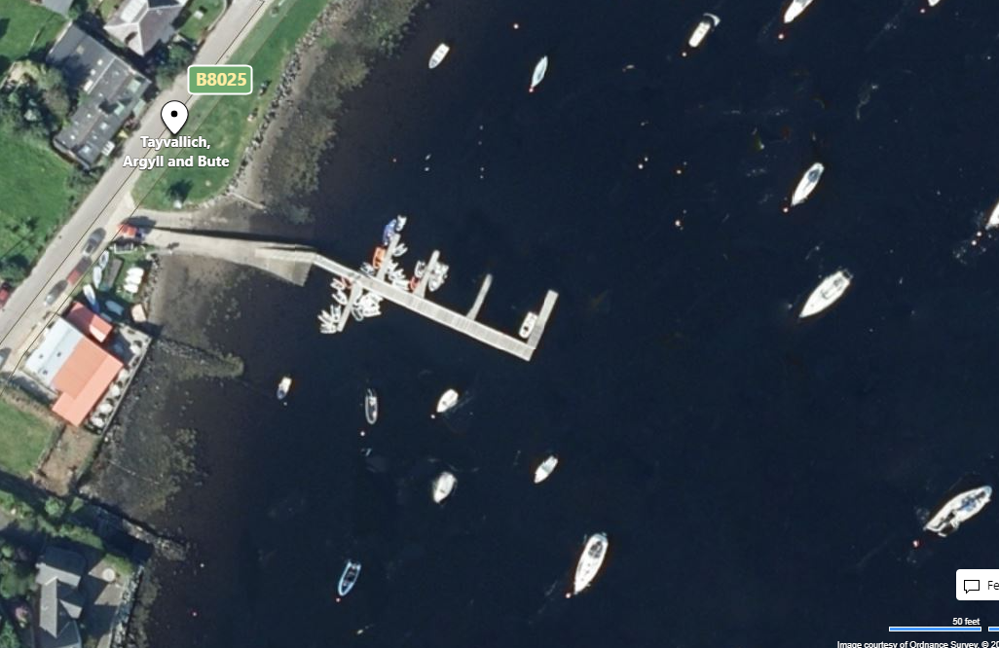
Phase 1 – Pontoon Upgrade January 2022 (funded by Transport Scotland and TBA) Completed 2022
Main features of this upgrade:-
Extension of pontoon
Recovering of main pontoon surface with mini mesh
Power installation
(Replace gangway)
Notes:
Dougie – do you want to give an update…….

Slide 19
Project 1 – Dinghy / Paddlesports facility at Finlay’s pier
Main features of this upgrade:-
New floating facility for on-water dinghy storage
Safe and accessible launch and retrieval area for canoes, paddleboards, etc.
Electric outboard charging stations
Notes:
At the last AGM we also agreed that we would apply to the CE for a grant of approx. £350k to fund a larger project. We successfully reached stage 2 of the application process. Included Project 1 2 3. (click through)
The majority voted not to progress with the application and to focus on maintaining our current facilities.
So if we skip to project 4 …..

Slide 20
Project 2 – Foreshore and concrete pier upgrade
Main features of this upgrade:-
Sailing club launch ramp and dinghy storage
Onshore dinghy storage racks
Full repair/upgrade of the concrete pier
Build lean too structure to house solar panels which can charge power pedestals on the pontoon. Lean too can be used for shelter for sailing club/village events.
Create access to café terrace to allow access to shower facilities.
Notes:
The committee propose that we retain these ideas in the plan. Acknowledging that they can’t be funded through membership fees. We will continue to apply for any relevant funding.
Good new – only 3 short slides left…….

Slide 21
Upgrade to Carrick Pier
Add water supply
Add floating pontoon
Add power supply

